Slide 1


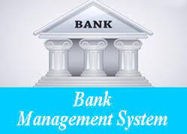
BANKING DATABASE MANAGEMENT SYSTEM
hxhss

Slide 2
PROJECT MEMBERS INFORMATION
NITIN JIBAHU GANGURDE
(2019BCS113 ) (DIV –A)
ABHIJEET SHISHUPAL DAMAHE
(2019BCS015 ) (DIV – A)
SAURABH DNYANESHWAR GHODAM
(2019BCS058 ) (DIV – B)
GUIDED BY :- MRS. JAISHRI WAGHMARE (MAM)
(HOD OF COMPUTER SCIENCE
DEPARTMENT SGGS,NANDED)

Slide 3
SOFTWARE USED WITH THEIR PURPOSE
Front End/Language :- HTML ,CSS, JAVASCRIPT,PHP
Purpose :- HTML :-Provides the basic structure of sites,
which enhanced and modified by other
technology like CSS and JavaScript.
CSS :- is used to control presentation, formatting,
and layouting.
JAVA SCRIPT :- is used to control the behavior of
different elements.
Back End/Database : - MYSQL :- Including data , Warehousing ,logging
application and Web database handling.
Additional Tools : - XAPM Server :- allows you to build Word Press site
offline, on a local web server on your computer.
Operating System : -Windows 8

Slide 4
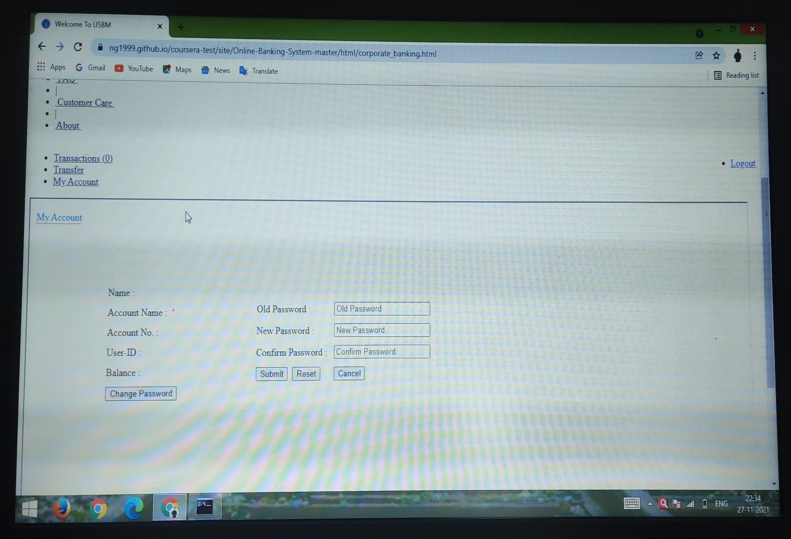
DESIGN PICTURES OF BANKING WEBSITE

Slide 5
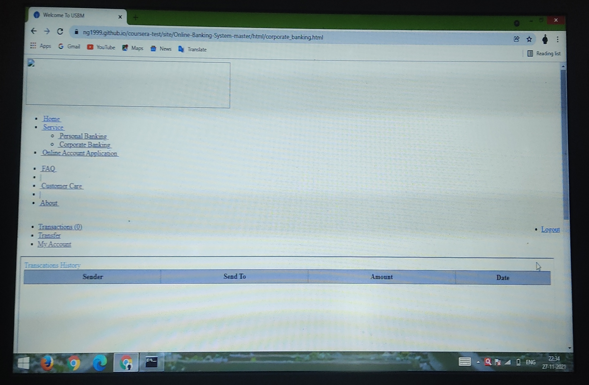
DESIGN PICTURES OF BANKING WEBSITE

Slide 6
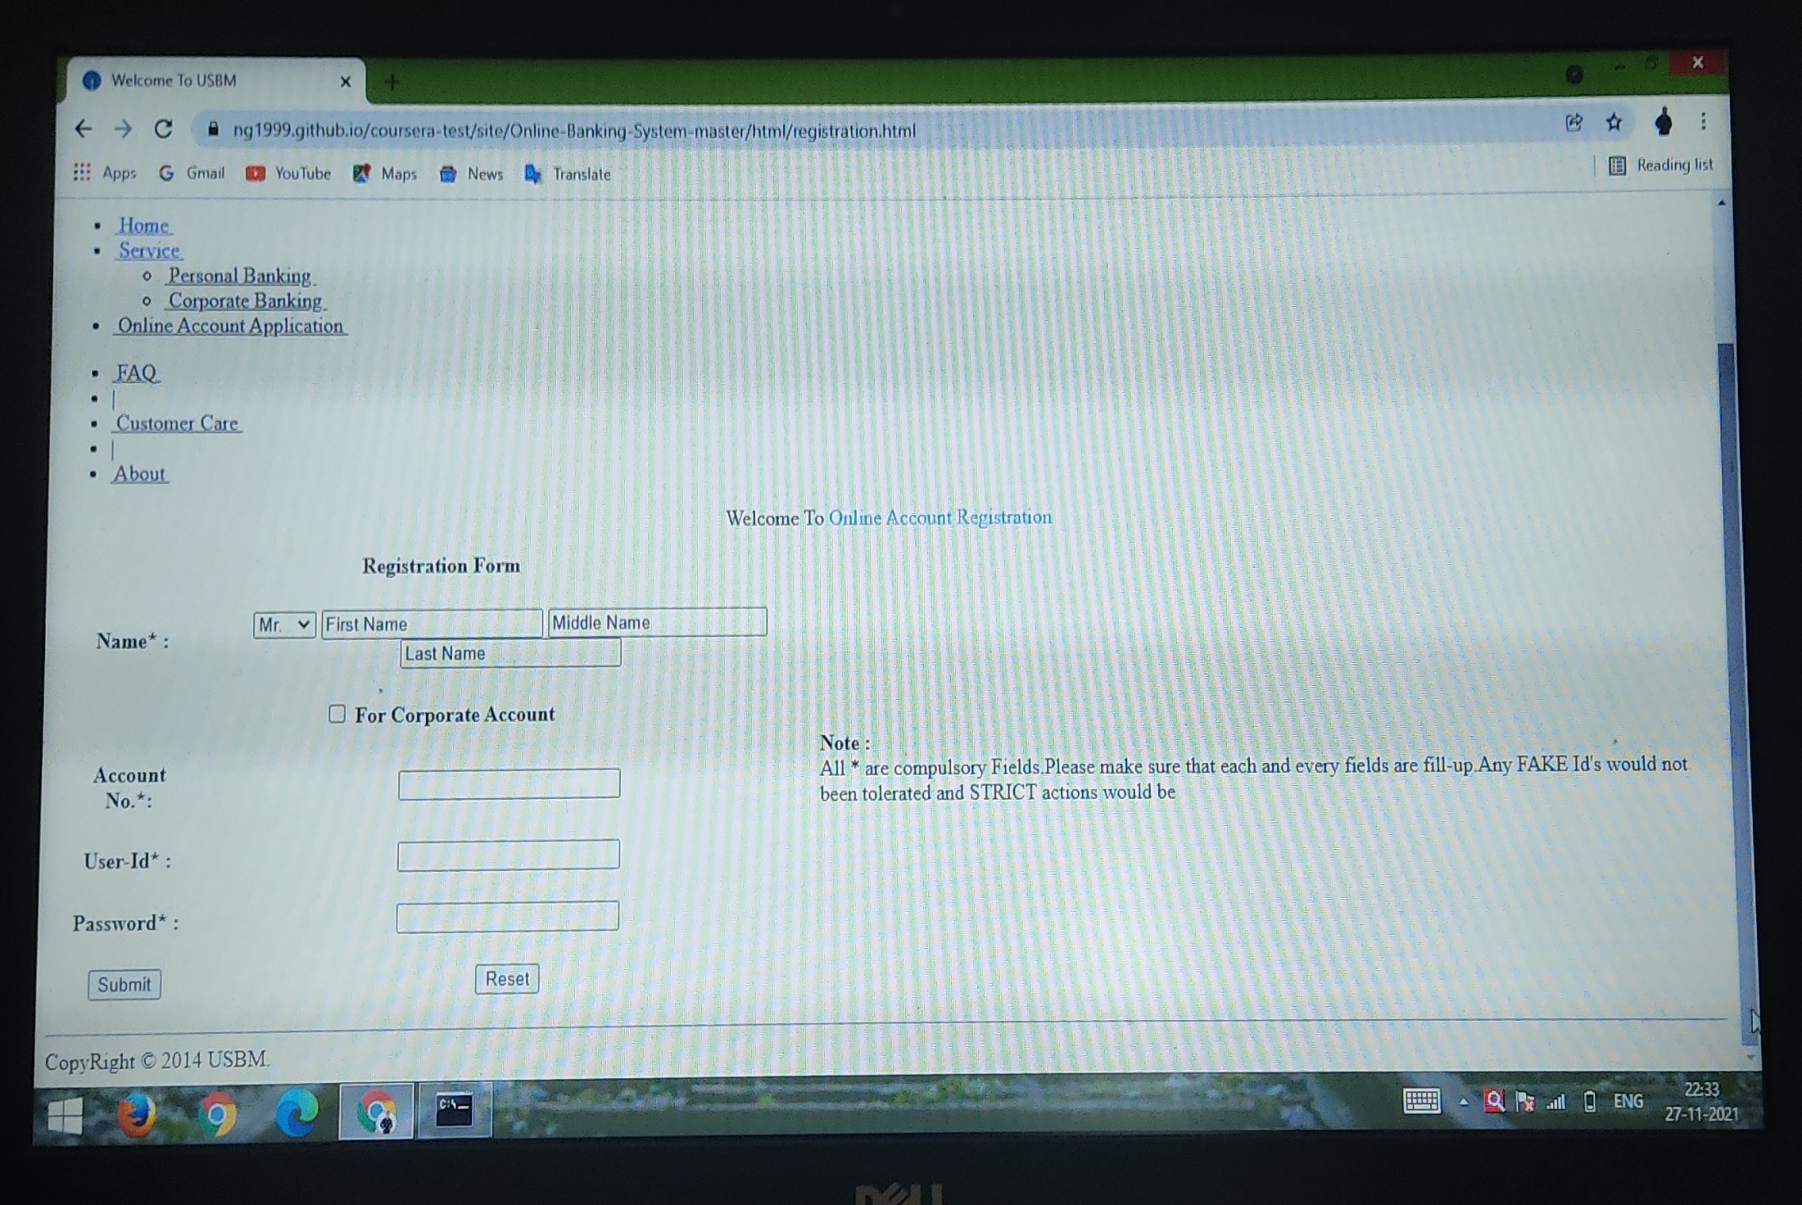
DESIGN PICTURES OF BANKING WEBSITE

Slide 7
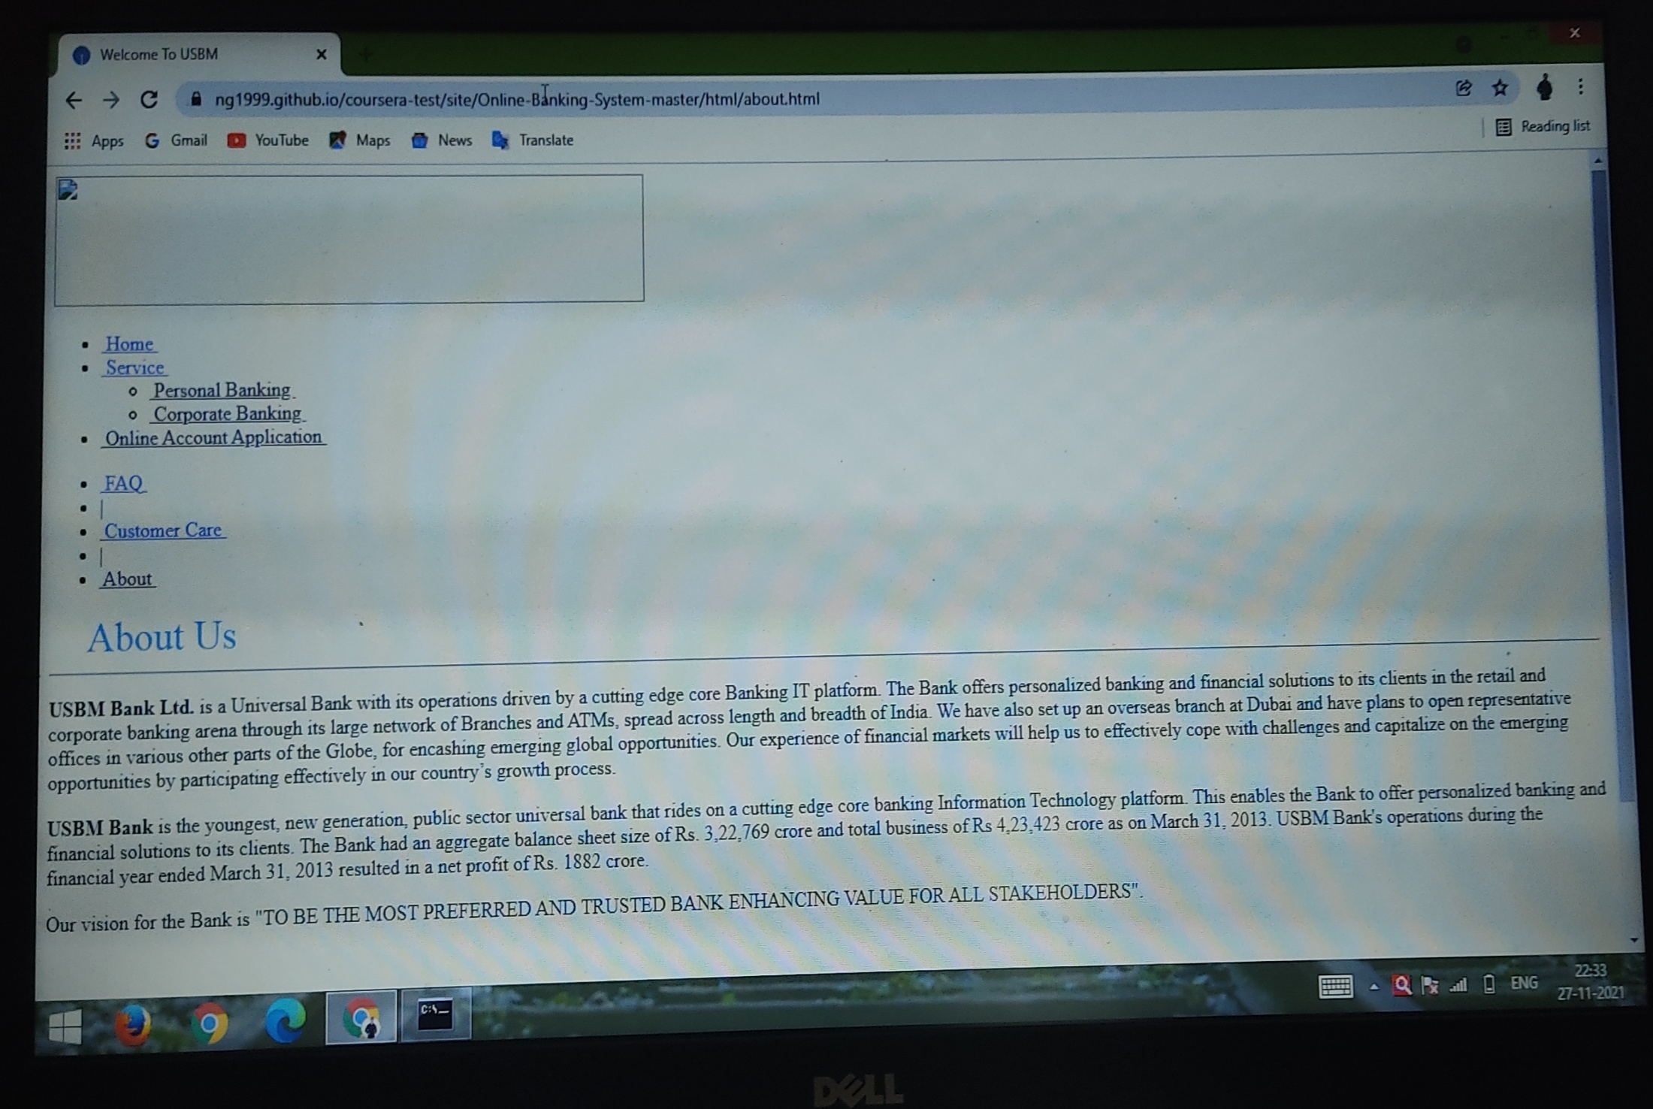
DESIGN PICTURES OF BANKING WEBSITE

Slide 8
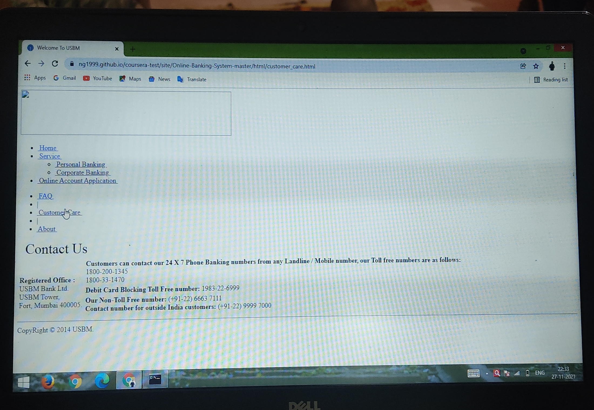
DESIGN PICTURES OF BANKING WEBSITE

Slide 9
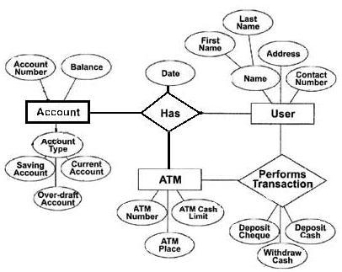
ER DIAGRAM
ER DIAGRAM BANKING SYSTEM

Slide 10
REPORT OF BANKING DATABASE SYSTEM
INTRODUCTION
The “Banking Database Management System” project is a model Internet Banking Site. This site enables the customers to perform the basic banking transactions by sitting at their office or at homes through PC or laptop. The system provides the access to the customer to create an account, deposit/withdraw the cash from his account, also to view reports of all accounts present. The customers can access the banks website for viewing their Account details and perform the transactions on account as per their requirements. With Internet Banking, the brick and mortar structure of the traditional banking gets converted into a click and portal model, thereby giving a concept of virtual banking a real shape. Thus today's banking is no
longer confined to branches. E-banking facilitates banking transactions by customers round the clock globally.

Slide 11
Main Purpose of Banking
The Traditional way of maintaining details of a user in a bank was to enter the details and record them. Every time the user needs to perform some transactions he has to go to bank and perform the necessary actions, which may not be so feasible all the time. It may be a hard-hitting task for the users and the bankers too. The project gives real life understanding of Online Banking System and activities performed by various roles in the supply chain. Here, we provide automation for banking system through Internet. Online Banking System project captures activities performed by different roles in real life banking which provides enhanced techniques for maintaining the required information up-to-date, which results in efficiency. The project gives real life understanding of Online Banking System and activities performed by various roles in the supply chain.

Slide 12
Functions Of Banking System
1. View balances: Firstly login your account with your account number and password. Then checking your balance doesn't require much work. You simply select Account balances and take a look at your balance and past transactions. If you have more than one account, you can also do transfers between accounts.
2. Transfer funds: When you select Transfer Funds, you'll be asked where to transfer
the money to and from, when, and the amount.
3. Set up recurring bill payments or transfers: If you make a regular payment every
month, it might be convenient to set up an automatic withdrawal from your account.
4. Monitor CIBC investments: If you have any CIBC investments, you can keep an eye on those stocks or mutual funds here.
5. Pay bills: To pay your bills online, you just need to add to your account the names of the companies you wish to pay bills to.
6. View our VISA* accounts: Always a good place to monitor your spending. You can
make your credit card payments online, right from your account.
7. Order Cheques: We don't need them much anymore due to online banking and debit purchases, but if you still use cheques, you can order them directly from the BAMS website.

Slide 13
Admin Module for Banking System
1. Admin login
2. Add/delete/update account
3. Withdrawal/deposit/statements transaction
4. Account Information
5.User details list
6. Active/Inactive account
7.View transaction histories
User Module for Banking System
1. User login, use PIN system
2. Creating/open new account registration
3. Funds transfer (local/international/domestic)
4. View statements transaction
5.User account details
6. Change Password

Slide 14
Banking Database System Description
1. Create New Account: A customer who having the account in the world can create a virtual account through this module. This module receives the customer profile details and the bank account details with the proof of the ownership of the bank account.
2. Login: Virtual account holders can login in to the system using this module. Thus this is the secured login page for the customers in the website.
3. Virtual Account: After the approval of new virtual account creation, the customer assigned a unique virtual account number to make the online money transactions. This module views the details of the logged customer's virtual account.
4. Bank Accounts: A customer may have more than one bank account in various banks, in this case, the customer prompted to decide which bank account should reflect in the account debit or amount credit. For these operations customers can add their owned bank accounts here and it will be approved by the administrations of the system.
5. Fund Transfer: This is the module to make fund transfer to the virtual bank account holders or the usual bank account holders from the customer's specified bank account.

Slide 15
Online Banking Tips
1. URL address on the address bar of your internet browser begins with "https"; the letter’s at the end of "https" means 'secured'.
2. Look for the padlock symbol either in the address bar or the status bar (mostly in the address bar) but not within the web page display area. Verify the security certificate by clicking on the padlock.
3.Do not enter login or other sensitive information in any pop up window.
4. The address bar has turned to green indicating that the site is secured with an SSL Certificate.

Slide 16
Conclusion Of Banking Report
This project is developed to nurture the needs of a user in a banking sector by embedding all the tasks of transactions taking place in a bank. Future version of this project will still be much enhanced than the current version. Writing and depositing checks are perhaps the most fundamental ways to move money in and out of a checking account, but advancements in technology have added ATM and debit card transactions. All banks have rules about how long it takes to access your deposits, how many debit card transactions you're allowed in a day, and how much cash you can withdraw from an ATM. Access to the balance in your checking account can also be limited by businesses that place holds on your funds. Banks are providing internet banking services also so that the customers can be attracted. By asking the bank employs we came to know that maximum numbers of internet bank account holders are youth and business man. Online banking is an innovative tool that is fast becoming a necessity. It is a successful strategic weapon for banks to remain profitable in a volatile and competitive marketplace of today.

Slide 17
Feature of Banking Management System
1. Transferring amount to the local customer account number.
2. Admin must approve the user account activation before it can be used and transferring funds, view statement history.
3. Customer gets to know his last login date and time each time he logs in.
4. Customer can check all transactions made with their account.
5.Customer can check their account statement within a date range.
6.Customer can request for ATM and Cheque Book.
7. Admin can add/edit/delete customer account’s
8. All two of them (customer & admin) can change their password.
9. Admin Login pages are hidden from customer for security purpose.
10. Passwords are stored as encrypted hashes with an additional random salt for added security.
11. User registration for online banking if not register.
12. Adding Beneficiary account by customer.

Slide 18
Details Of Work Completed
1) 60% structural part for web development is completed.
2) 40% database part is uploaded.
3) 20% design of web is completed.
4) 80% Report writing is completed.
5) 10 % layout and Behavior is completed .
Details of Work Remaining
1) 40% structural part for web development is remaining.
2) 60% database part is remain to upload.
3) 80% design of web is remaining.
4) 20% report writing is remaining.
5) 90% layout and Behavior is remaining.

Slide 19
Benefits Of Online Banking System
1. Online banking with key bank is fast, secure, convenient and free.
2. Quick, simple, authenticated access to accounts via the web application.
3. Simply scalable to grow with changing system requirement.
4. Global enterprise wide access to information.
5. Improved data security, restricting unauthorized access.
6. Minimize Storage Space.
7. You don't have to wait in line.
8. You don't have to plan your day around the bank's hours.
9. You can look at your balance whenever you want, not just when you get a statement.
10. It's also helpful to watch how much interest you're gathering on investments and savings or what service charges you have incurred.

Slide 20
References used for Banking System Project
1. Article: Online banking, Website: https://en.wikipedia.org/wiki/Online_banking
June 29, 2015, 12.30 am.
2. Online Bank Account Management System
Website: http://www.slideshare.net (Collect some info for report documents, 2014-
2015)
3. Learning MYSQL, JavaScript, jQuery, PHP, HTML, CSS3,
Website: http://www.w3schools.comm, 2014-2015
4. PHP and MySQL video tutorials, Oct 2014-2015
Website: http://www.freebanglatutorial.com, http://www.youtube.com
5. Veneeva, V. (2006), “E-Banking (Online Banking) and Its Role in Today's Society”,
Ezine articles, June 30, 2015
6. JavaScript validation for empty input field, (May 10, 2015)
Website:http://stackoverflow.com/questions/3937513/javascript-validation-for-empty-input-field.

